Slide 1
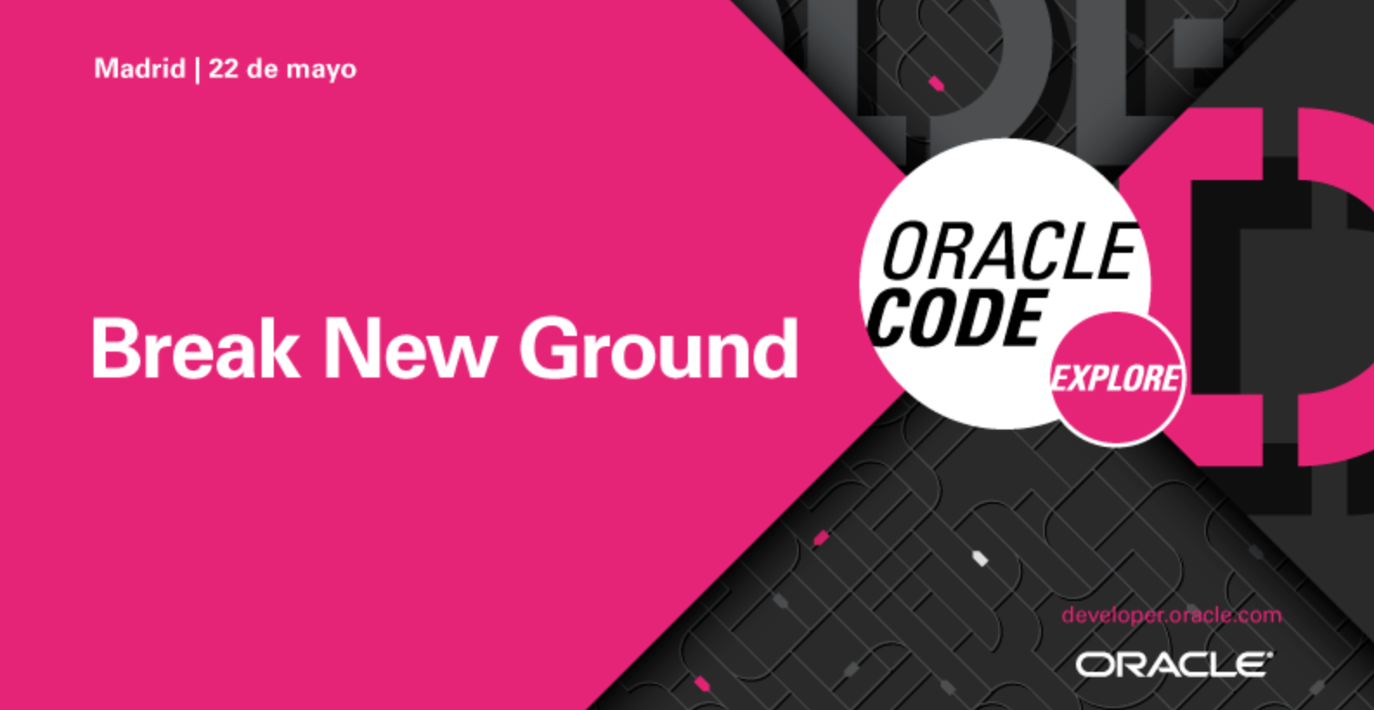
Notes:
Containers and Cloud Native technologies require developers, DevOps professionals, and software architects to adopt a new set of frameworks, which can present challenges.
Culture and Complexity:
Many organizations are faced with delivering modern apps while evolving from traditional development. They have application lifecycles that have to be integrated with new tools for DevOps workflows, including containers and serverless technologies. Thre is a need for better training and tools. Even if you do acquire the training, the setup and maintenance of cloud native technologies can require substantial operational expertise and can be an expensive endeavor.
Source: https://thenewstack.io/3-cloud-native-challenges-to-address-now-culture-code-and-cloud/
Unreliable DIY Approaches:
Do-it-yourself (DIY) approaches may lack enterprise-grade reliability, security, scaling, and manageability. Even if you put together various tools, including those for container orchestration, serverless, build pipelines, streaming and infrastructure as code, your Ops team will likely be overwhelmed by issues to troubleshoot and just keeping the lights on.
Fragemented Tools
There are various tools you need to piece together to get a holistic solution. The CNCF landscape lists 100s of tools for cloud native, including 8 graduated projects, 15 incubating projects, and 436 member projects. Piecing together these various tools can be inefficient and expensive. Among the graduated projects, developing the in-house operational expertise may not be worth the ROI. Among the incubating and member projects, organizations have to invest in software that may have bugs, including security flaws that can expose them to vulnerabilities.
Proprietary Software:
Software from other cloud vendors (AWS in particular) and application development vendors such as Pivotal and Red Hat can lock you into proprietary stacks. As a result, you will operate in a closed ecosystem with non-standard ways of provisioning, monitoring, and managing your cloud native aaplications.

Slide 2
Staff
Demos | Staff
Gigi’s Pizza | Iván / Lillo / Luisinho
Industry | Casares / Zárate / David Mauri
Help Desk (por la mañana) | Staff
Corner | Jesús G / Stephane / Oscar / Samu
Workshop Room #1 | Staff
Coordinator | Jesús G
Owner | Olivier
Encargado Lab #1 (video) | Olivier
Staff | Luisinho / David M / Samu / Lillo
Workshop Room #2 | Staff
Coordinator | Guillermo Best
Owner | Stephane
Encargado Lab #1 (video) | // TBD
Staff | Paco / Pepe / Oscar
Notes:
1) Demos
People: - Iván, JesúsB, Luisinho, Mauri, Lillo, Samu, Casares, Zárate - GBest's team: Olivier, Paco, Stephane, Pepe, David Mauri y Oscar Sanchez
Gigi's + robot Staff: Iván / Lillo / Luisinho
Industry Staff: Zárate / Casares
2) Soporte técnico a asistentes que vayan a realizar el taller La idea es tener un stand donde podamos realizar asistencia. Mañana lo vemos sobre el terreno
3) Soporte a activación de trials
//TO DO
4) Workshops
Sala 1 Coordinator: Jesús Guerra Owner: Stephane Support staff:
Sala 2 Coordinator: Guillermo Best Owner: Oscar Sánchez Support staff:

Slide 3
Workshop Bienvenida
Material
https://github.com/codeexploremadrid/codeexplore
Estamos para ayudaros
WIFI
Nombre: MIOTI
Contraseña: Z6EEFNWdNNV9
El taller no termina hoy…
Have fun!!!!

Slide 4
Workshop Agenda
Time | Track
15:00-15:15 | Bienvenida
15:15-15:45 | Lab 0: Setup del entorno y configuración de Developer Cloud Service
15:45-16:30 | Lab 1: Implementación de un patrón CQRS con Data Integration Platform y Rest Data Services
16:30-17:00 | Lab 2: Despliegue de Microservicios y Portable Data Bases con Kubernetes sobre Oracle Multitenant
17:00-17:30 | Lab 3: Despliegue de un microservicio con Developer Cloud Service y ATP

Slide 5
Lab #0

Slide 6
Lab #1

Slide 7
Lab #2

Slide 8
Lab #3

Slide 10
1 | 2 | 3 | 4 | 5

